Slide 1
Federated Learning for Traffic Flow Prediction
Rakshith Ravi Masters in AI Engineering of Autonomous Systems
rar5407@thi.de

Slide 2
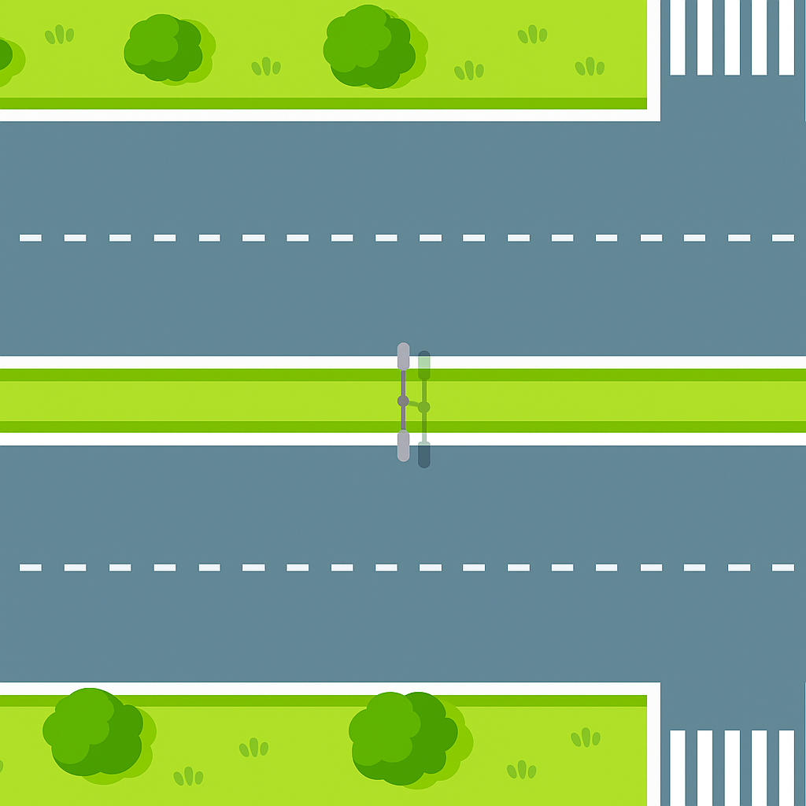
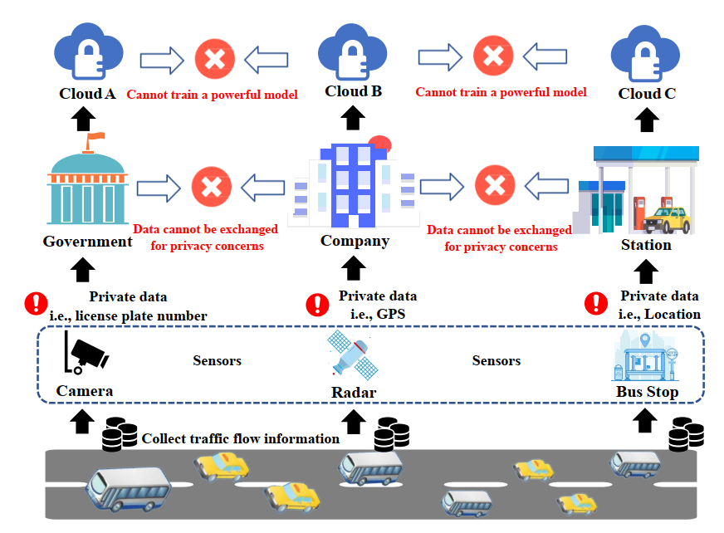
Introduction
Motivation and Need for Research of Traffic Flow Prediction (TFP)
Urban planning and traffic control
Impacts on land use
Crucial for traffic management
Sustainable urban development
Critical function of Intelligent Transport Systems
Problem with Traditional Methods
Centralized Machine Learning Techniques
Significant data privacy and security risks
Stricter data privacy regulations
[1] Y. Liu, J. Yu, J. Kang, D. Niyato, and S. Zhang, “Privacy-Preserving Traffic Flow Prediction: A Federated Learning Approach,” *IEEE Internet of Things Journal*, 2020
Fig. 1. Privacy and security problems in traffic flow prediction[1]

Slide 3
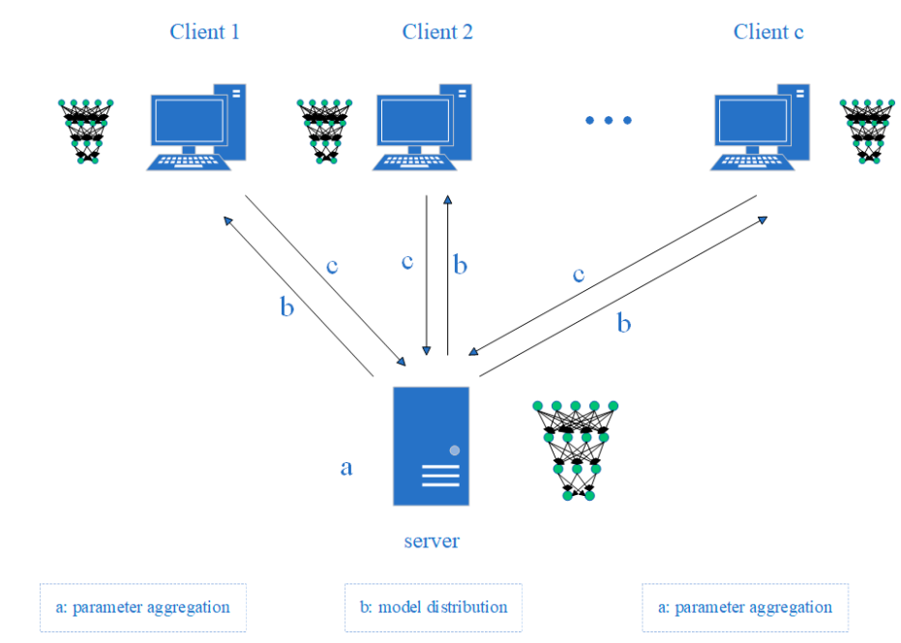
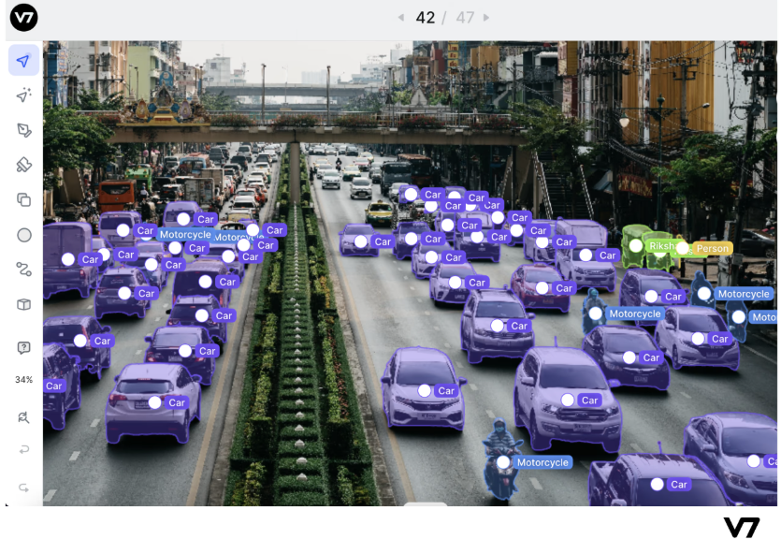

Introduction
Federated Learning (FL)
Privacy preserving machine learning model developed by Google in 2016.
Advantages of FL over Centralised Machine Learning Techniques in TLP
Collaborative model training without raw data sharing
principle: “Bring the code to the data, not the data to the code”
Clients train locally on private data
Clients send only model updates to a central server
Server aggregates updates to form a new global model
Reduces data transfer workload and ensures privacy
Fig. 2. Collaborative training process of federated learning[7]
Fig. 3. Road object detection for traffic flow analysis in V7 Credit : https://www.v7labs.com/blog/federated-learning-guide
[7] G. Bo and J. Tang, “A Short-Term Traffic Flow Prediction Method Based on Personalized Lightweight Federated Learning,” *Italian Nat. Conf. on Sensors*, 2025.
.

Slide 4
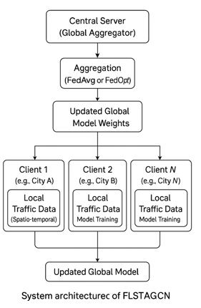
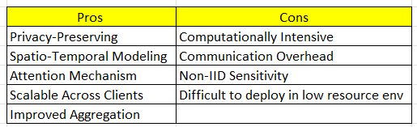
Methodology: FL Architectures for Traffic Flow Prediction
FLSTAGCN Model
Combines FL with Spatial-Temporal Attention GCN (STAGCN)
Shi et al. (2024) demonstrated FLSTAGCN using real-world traffic datasets (e.g., PeMSD7, METR-LA) to predict short-term traffic speed and flow.
Results showed competitive accuracy when compared with centralized models like DCRNN and STGCN.
Real world Application Potential - Smart Cities Traffic Systems, Regional Traffic Authorities Collaboration, Connected Vehicles / Edge Devices, Event Management and Urban Planning, Autonomous Vehicle Infrastructure.
Fig. 4. System architecture of FLSTAGCN model
[5] L. Shi et al., “FLSTAGCN: Traffic Flow Prediction Based on Federated Learning and Attention Graph Convolutional Network,” *Proc. IEEE Int. Conf. Systems, Man and Cybernetics*, 2024.

Slide 5
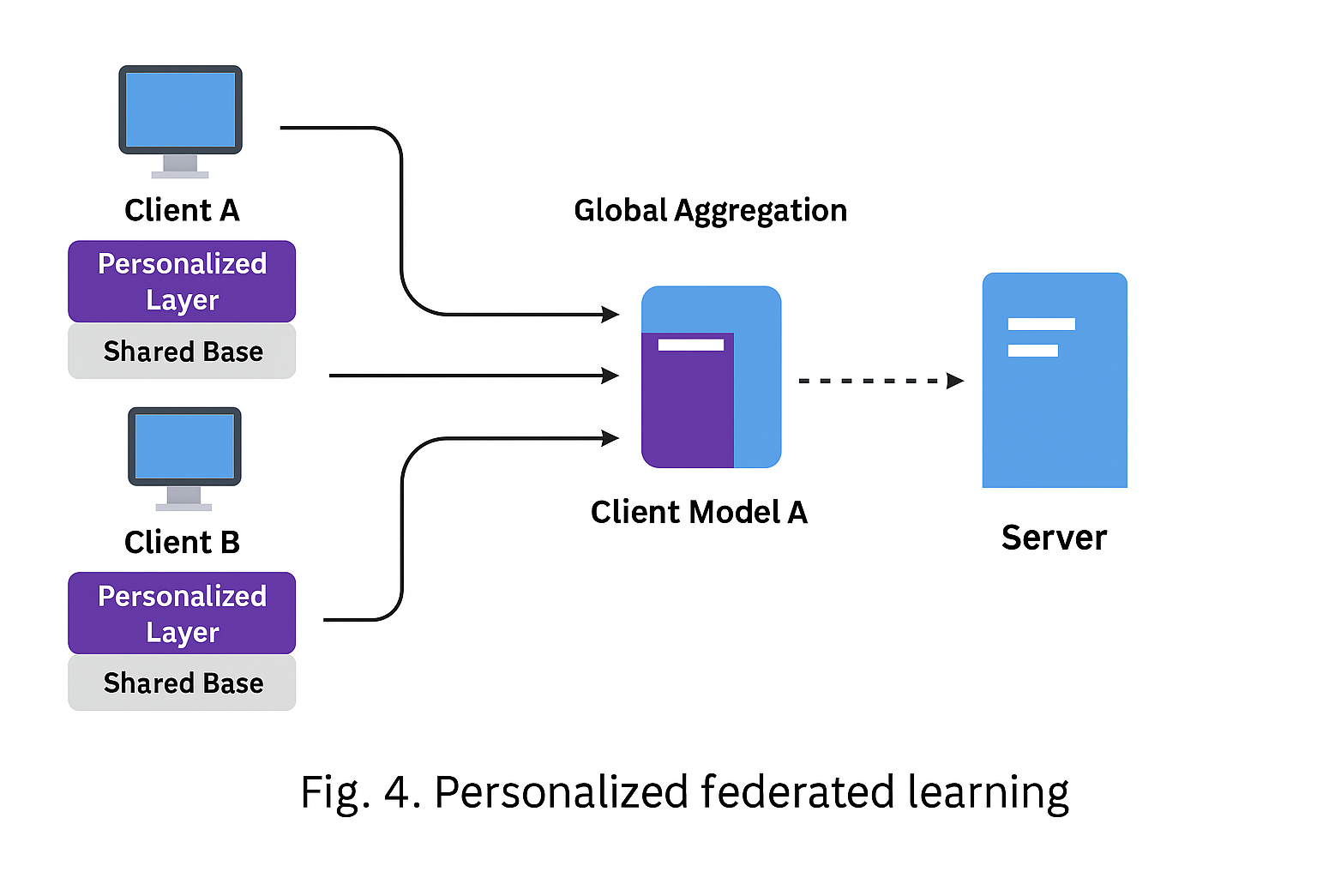
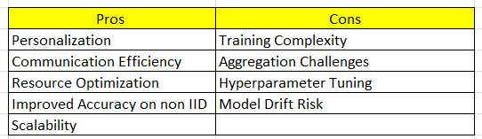
PLFL Model
Dynamic model pruning + weighted client personalization.
Cities with region-specific traffic patterns .
Used in highway management systems where rural, urban, and high-density areas have different traffic behaviors.
PLFL personalizes predictions for each region without data sharing.
Other Applications - Healthcare, Finance and E Commerce
Fig. 5. Personalized Federated Learning Visual Workflow
[8] J. Guo, X. Feng, and H. Zheng, “Personalized Federated Learning with Neighbor Aggregation for Traffic Flow Prediction,” *Int. Conf. Innovative Computing and Cloud Computing*, 2023.
[18] H. Lai, J. Guo, X. Feng, and H. Zheng, “Communication-Efficient Personalized Federated Learning for Traffic Flow Prediction,” *Int. Conf. Innovative Computing and Cloud Computing*, 2024
[7] G. Bo and J. Tang, “A Short-Term Traffic Flow Prediction Method Based on Personalized Lightweight Federated Learning,” *Italian Nat. Conf. on Sensors*, 2025.

Slide 6
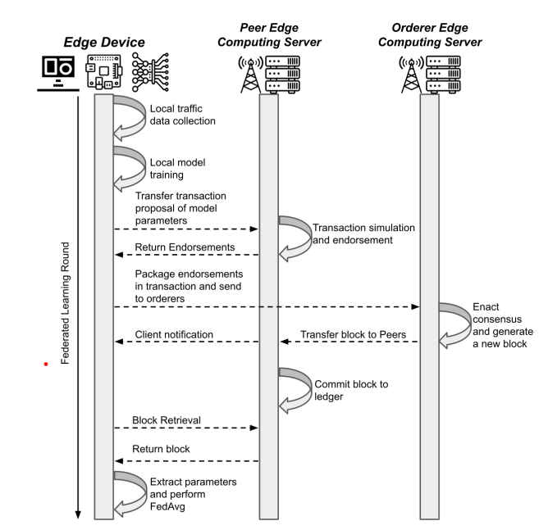
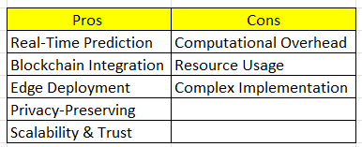
BFRT Model
Blockchained Federated Real-Time Traffic Prediction
Real-Time/Online FL Models for TFP.
Authors used real-world traffic datasets (like METR-LA or PeMS) and simulated RSU deployment scenarios to validate real-time prediction.
BFRT achieved lower real-time predictive error compared to standalone FL or centralized methods.
Real-World Applications - Urban Traffic Control Centers, Autonomous Vehicle Infrastructure, Smart Highways / Tollways, City Wide Fleet Management
Fig. 6. Workflow of the BFRT system [10]
[10] C. Meese, H. Chen, S. Asif, W. Li, C. Shen, and M. Nejad, “BFRT: Blockchained Federated Learning for Real-time Traffic Flow Pre diction,” *Proc. IEEE/ACM Int. Symp. Cluster, Cloud and Internet Computing*, 2022.

Slide 7
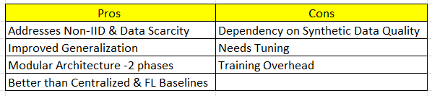
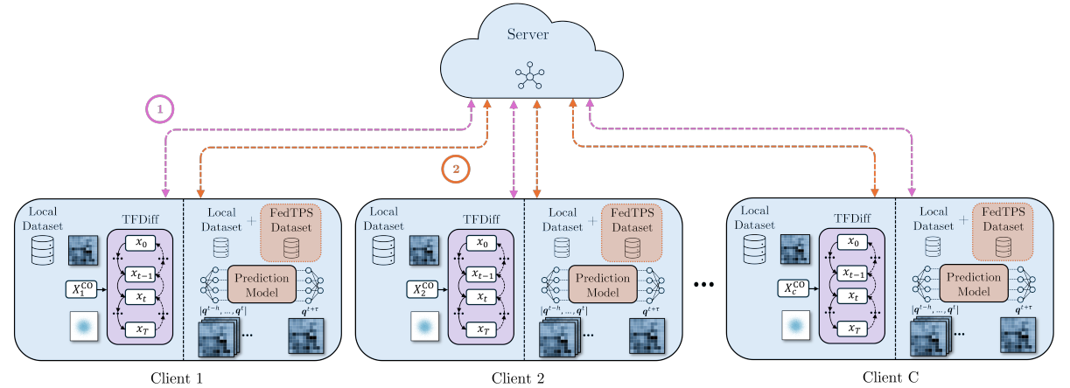
FedTPS Model
Regions with limited sensor coverage (e.g., rural or newly developed areas) benefit from synthetic data to simulate missing traffic patterns.
Other Applications - Healthcare, Finance and Retail.
Stage 1 trains the federated diffusion model to develop the FedTPS synthetic dataset
Stage 2
trains the federated traffic flow prediction model with the client’s local dataset & synthetic data
Fig.7. FedTPS Framework for training a federated generative model and subsequent traffic flow prediction model [17].
[17] F. Orozco, P. de Gusmao, H. Wen, J. Wahlstr¨ om, and M. Luo, “Federated Learning for Traffic Flow Prediction with Synthetic Data Augmentation,” *arXiv preprint arXiv:2403.56789*, 2024.

Slide 8
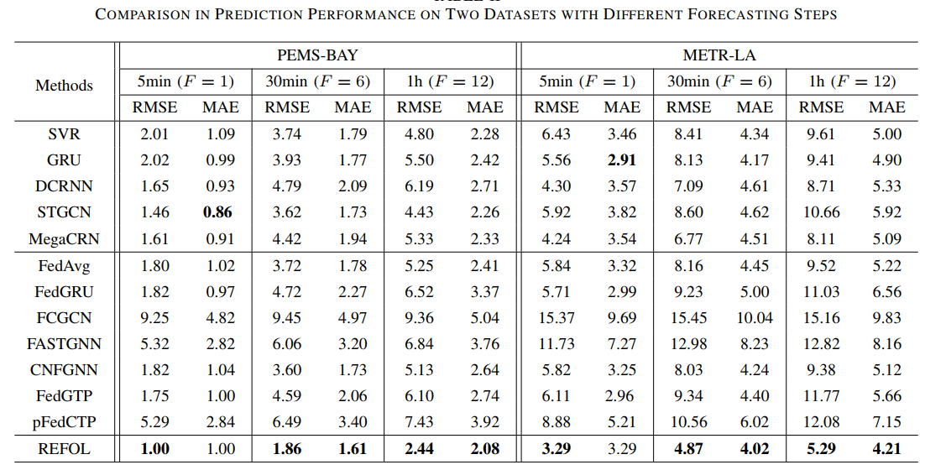
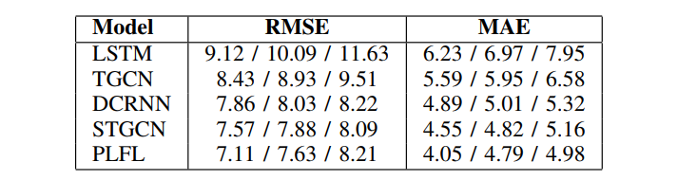
Results & Discussion
Multiple FL-based models evaluated using real-world datasets (METR-LA, PeMSD7, PeMSD4).
Performance measured using common metrics: Mean Absolute Error, Root Mean Square Error.
FL approaches consistently outperform centralized or baseline models.
COMPARISON OF PREDICTION PERFORMANCE OF DIFFERENT MODELS (RESULTS REPRESENT 5 MIN, 15 MIN, AND 30 MIN PREDICTION PERFORMANCE, RESPECTIVELY) [7].
REFOL performance compared with CNFGNN on PEMS-BAY and METR-LA datasets. (a, c) Predicted traffic speed vs. ground truth. (b, d) CDFs of absolute errors, showing REFOL’s lower error concentration [16].
[16] Q. Liu et al., “REFOL: Resource-Efficient Federated Online Learning for Traffic Flow Forecasting,” *IEEE Trans. Intell. Transp. Syst.*, 2024.
[7] G. Bo and J. Tang, “A Short-Term Traffic Flow Prediction Method Based on Personalized Lightweight Federated Learning,” *Italian Nat. Conf. on Sensors*, 2025.

Slide 9
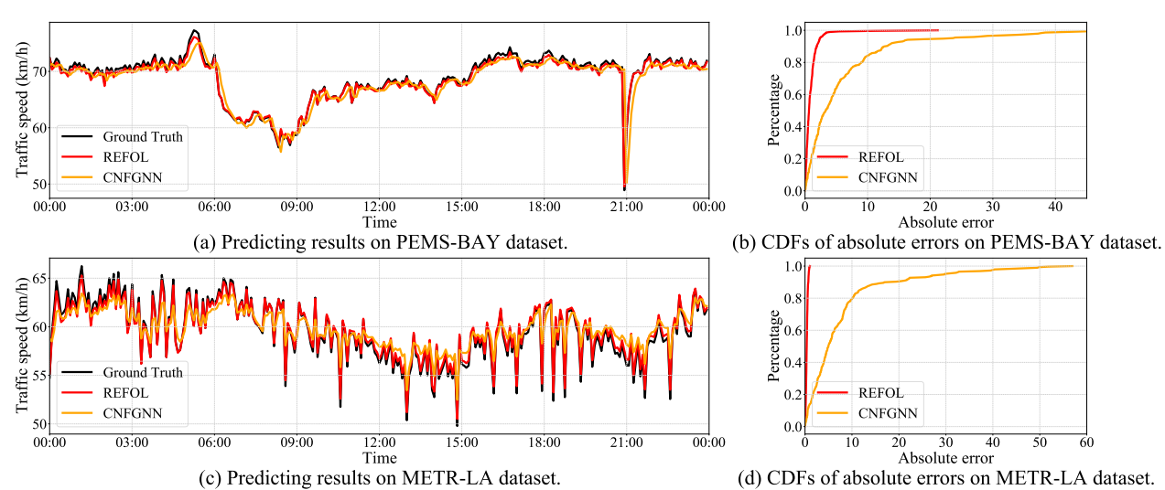
REFOL vs CNFGNN - Visual Performance
REFOL Curve Dominance in both datasets
Fig. 8. Ground truth values and forecasting values of CNFGNN and REFOL [16].
[16] Q. Liu et al., “REFOL: Resource-Efficient Federated Online Learning for Traffic Flow Forecasting,” *IEEE Trans. Intell. Transp. Syst.*, 2024.

Slide 10
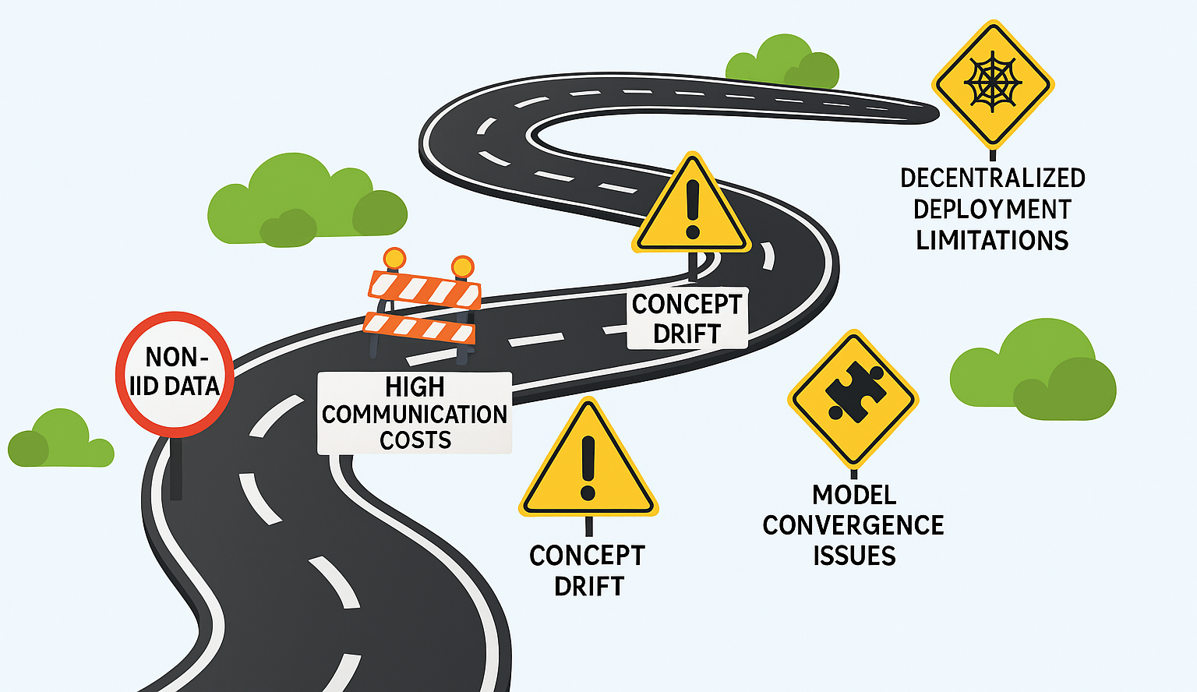
Challenges of Applying Federated Learning in Traffic Flow Prediction
Fig. 9. Challenges of Applying Federated learning in Traffic Flow Prediction

Slide 11





Conclusion
Federated Learning (FL) is a promising privacy-preserving, decentralized solution for Intelligent Transportation Systems (ITS).
Effectively addresses core Traffic Flow Prediction (TFP) challenges like: Data heterogeneity
Privacy constraints
Communication overhead
FL methods using deep spatio-temporal models (e.g., GNNs, GRUs, attention networks) achieve high prediction accuracy
Promotes ethical AI adoption by enabling collaborative model training without sharing raw data
Acts as a framework for collaborative intelligence, not just a theoretical concept.
Contributes to building smart, sustainable, and privacy-conscious urban mobility infrastructures

Slide 12
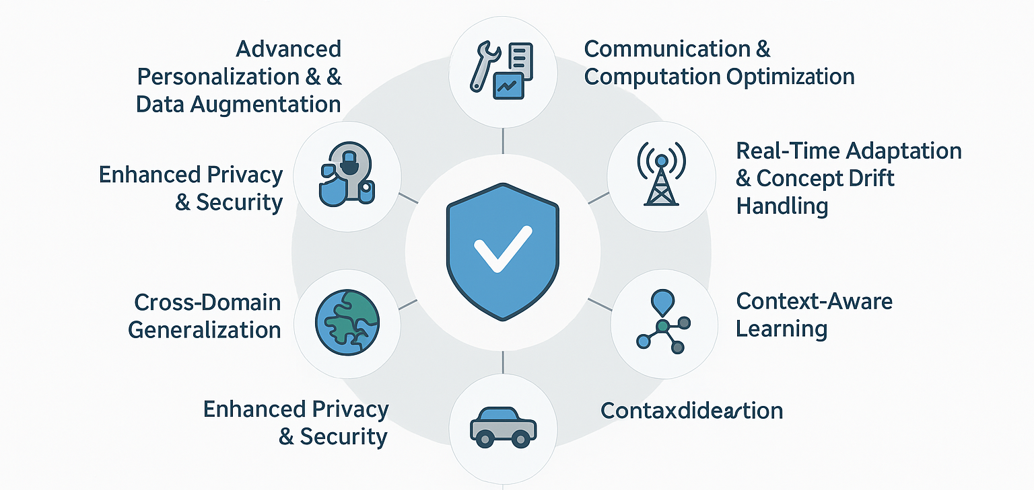
Future Directions and Research Gaps
Practical Deployment Challenges
Standardization

Slide 13
THANK YOU ! Q&A
Rakshith Ravi Masters in AI Engineering of Autonomous Systems
rar5407@thi.de

